Slide 1
Natural Calamities Monitoring system
Sunil Aluri
Instructor : Avnish Aggarwal
Internet of Things Class Project
06/09/2014

Slide 2
Damage Caused by Natural Disasters

Slide 3
What can we do about them?
Forecasting calamities based on the statistics.
Monitoring changes in the environment using different sensors, which gives early warning to the local people, without waiting for alerts from agencies and government bodies.
Building homes and other structures to tolerate the natural and manmade disasters.

Slide 4
How can bunch of sensors do the work?
Monitor the home surroundings for any irregularities in the atmosphere parameters.
Provide an early warning of natural calamities, disasters and their proximity.
Aggregate and analyze data from previous readings and predict the possible disasters.
Send the collected data periodically to the local Gov. Agencies, as well as nearby homes.
Talk to the weather channels and provide local alert if not triggered already.
Send texts, email alerts to all the persons living in the home, depending on their availability.
Data can be used to steady weather patterns more precisely and accurately.

Slide 5
Sample system using Mbed based IoTs
GEIGER COUNTER
ARDUINO MICRO
GAS SENSOR
MBED
UV SENSOR
SPARKFUN WEATHER STATION HUB

Slide 6
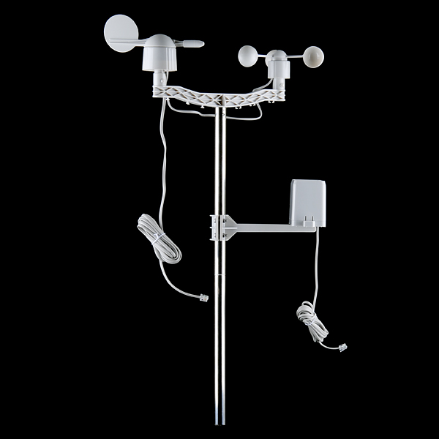
Weather Station

Slide 7
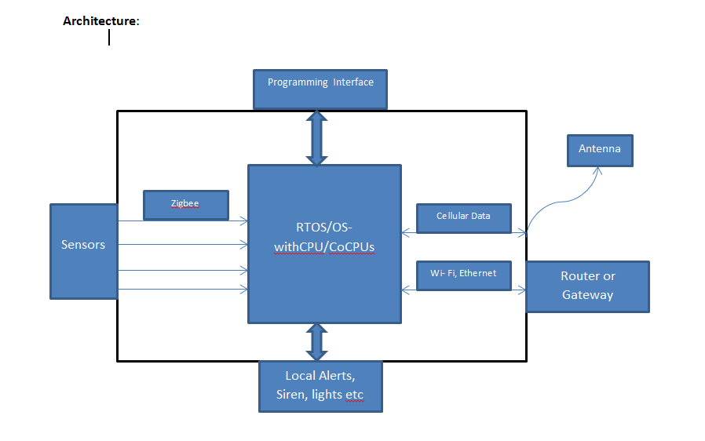
Architecture

Slide 8
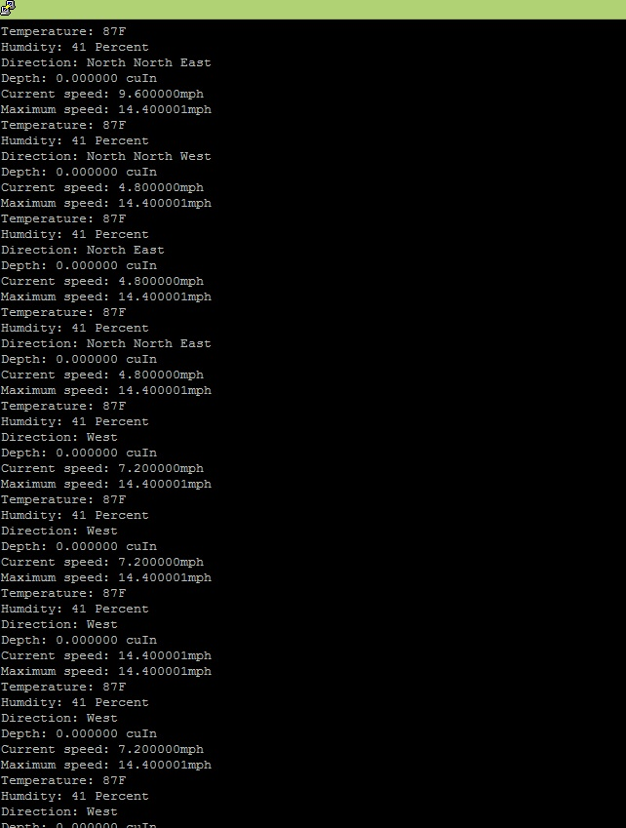
Weather Station Output

Slide 9
Upcoming Additions to the system
Xively Feed and Alerts using Zapier
Flood Sensor, Earthquake sensor using accelorometer.
Event prediction and heuristics.
Mesh network of multiple systems using Xbee or Wifly.
which simulates multiple near by houses updating data to each other, that might send early warning to the neighborhood.

Slide 10
Questions?

Slide 11
Thank You!!

