Slide 1
MBED
Hello World
Lab 1
mbed registration and hello world!
Notes:
Here is where we do a live demo.
Plug in mbed
Go to the website,
• Getting Started
• Downloading A program
• Compiling a Program
Take the tour
• Handbook
• Components
• Forum
• Blog

Slide 2
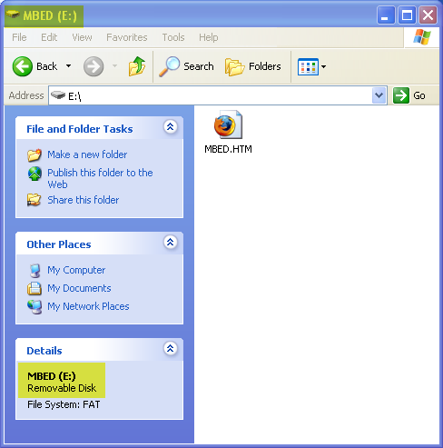
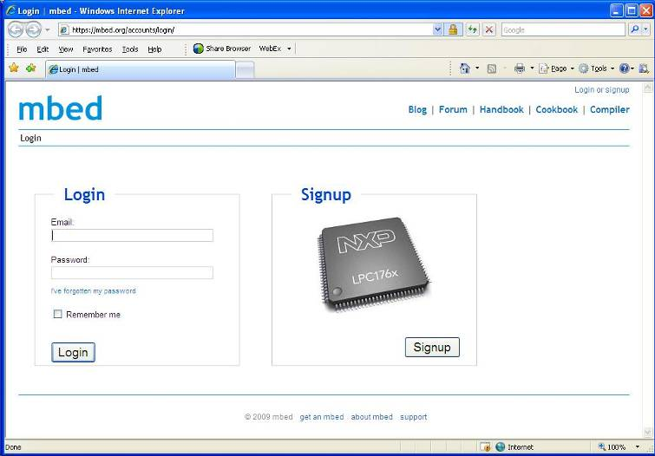
Registration
mbed microcontroller enumerates as a Mass Storage Device (USB disk)
Double-click the mbed.htm file on the mbed USB disk
Log in or sign up for a new account
Notes:
When you connect the mbed board, it presents itself as a standard USB Flash disk which the operating system can communicate with. This means that it can be plugged into a PC, Mac or Linux machine with no additional drivers.
The flash disk contains an HTML file that, when clicked, will open a web browser and direct you to http://mbed.org, where you can sign up for an account, or log in if you already have one.

Slide 3
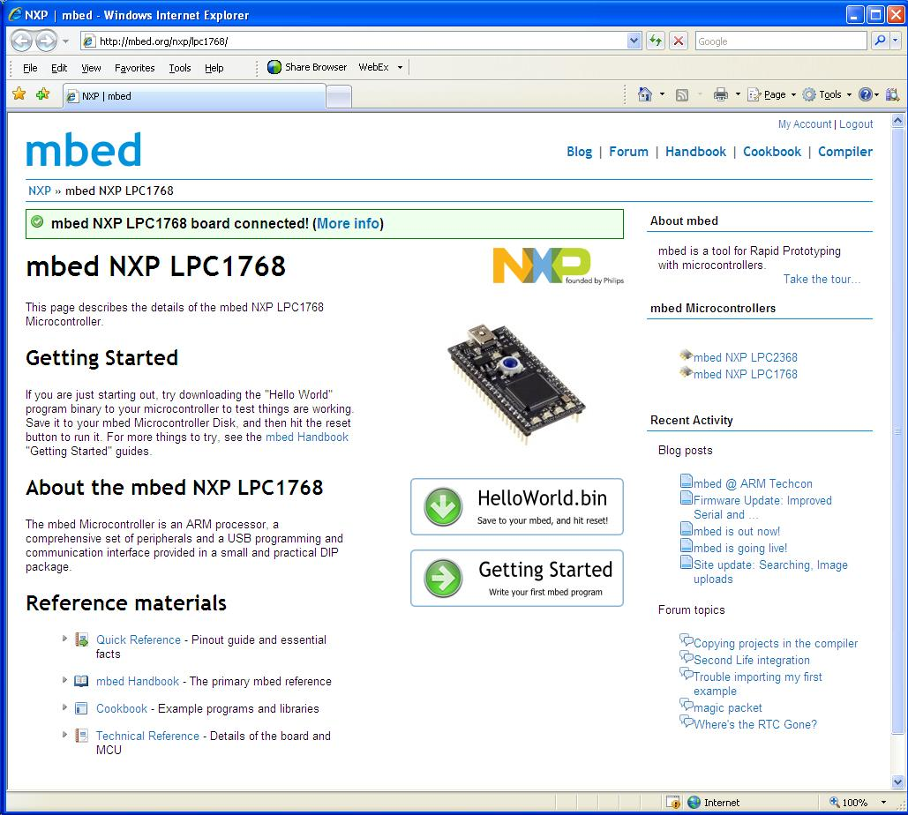
Getting Started
Useful resources linked from the first page, including very clear links to “Hello World” and the Getting Started guide
Compiler linked from front page
Notes:
On the front page of the mbed website are some useful resources. These are aimed at getting the new user up to speed as quickly as possible.
The first of these is a pre-built binary which can be saved to the mbed Microcontroller and run. It is a simple LED blinking program that proves that the binary is being downloaded and run correctly.
Next is the getting started guide. This is a walkthrough tour leading all the way through to compiling and running your first simple program.
It should be possible for a new user to have run through all these steps in a just a few minutes.

Slide 4
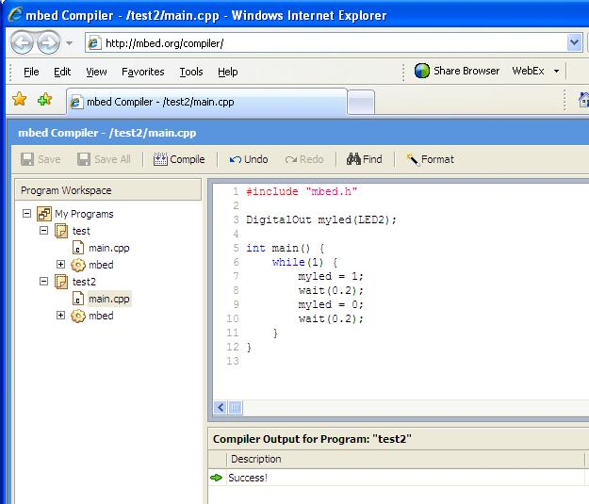
Getting Started
Create or open a project in the Program Workspace
Develop code in the
text editor
Save and compile
Compiler outputs
  Errors and warnings
  -or-
  A downloadable binary
Save to the USB flash disk
Notes:
The online compiler is a very simple IDE with RVCT installed on the web server back end. All of the options have been preset and are not configurable.
All the files are stored on the server, and all the editing is done locally, so the only internet traffic is when loading or saving files, or downloading a completed binary.
Being a regular compiler its output is what you’d expect. Errors and warnings with line numbers, and hints as to how your code is wrong, or a completed binary, ready to be saved to your mbed Microcontroller.

Slide 5
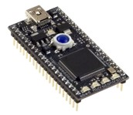
Getting Started
Once the file has saved to the flash disk, it needs to be programmed into the microcontroller
Press the button on the mbed module
Your code will start running!
Notes:
It is important to understand that the USB interface is a separate entity to the microcontroller running the binary.
When you save a binary to the mbed flash drive, you have done just that, stored a file on a flash drive. When you press the reset button on the mbed, the last binary file to have been saved onto the flash drive will be loaded into the microcontrollers memory, and run.
You can store other types of file on the USB flash disk, they will be ignored. Keep in mind that the flash drive has just 2Mb capacity.

Slide 6
MBED
Hello World
Lab 2
Rapid Prototyping: Other IO

Slide 7
DigitalOut and Analog Input
In the hello world session, we simply compiled the default program – blinky, but we didn’t take too much notice of the code
It was simple, it set up a digital output (DigitalOut) called “myled” and run a loop forever turning it on and off.
Lets see if we can begin to influence this using an analog input

Slide 8
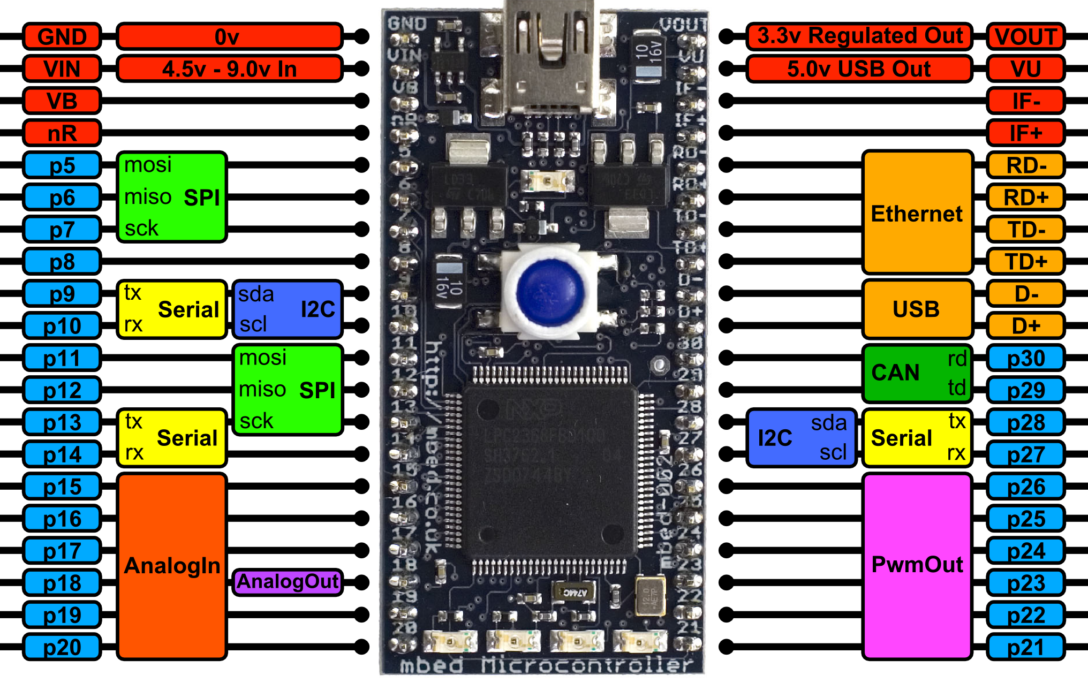
What IO is there?

Slide 9
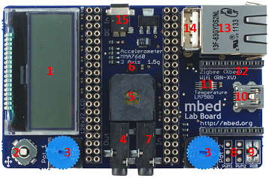
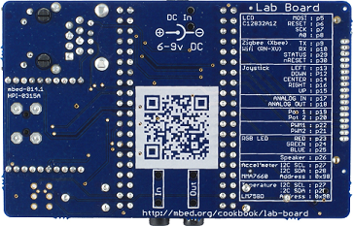
mbed application board
128x32 Graphics LCD
5 way joystick
2 x Potentiometers
3.5mm Audio jack (Analog Out)
Speaker, PWM Conencted
3 Axis +/1 1.5g Accelerometer
3.5mm Audio jack (Analog In)
2 x Servo motor headers
RGB LED, PWM connected
USB-B Connector
Temperature sensor
Socket for for Xbee (Zigbee) or RN-XV (Wifi)
USB-A Connector
RJ45 Ethernet conenctor
1.3mm DC Jack input
http://mbed.org/cookbook/mbed-application-board

Slide 10
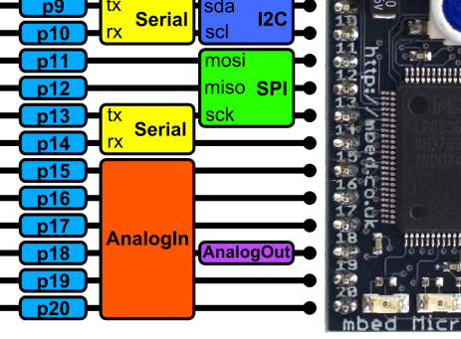
DigitalOut and Analog Input
The AnalogIn object returns a normalised float between 0.0 (0.0v) and 1.0 (3.3v)
Pot1 is wired between GND (0v) and Vout (3.3v), and is connected to pin “p19” – an AnalogIn

Slide 11
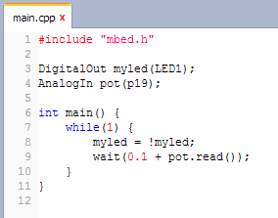
Challenge: DigitalOut and Analog Input
Write a program to give the LED in the first blinky program a delay of 0.1-1.1 seconds.
Write a program that turns LED1 on at 0.66v, LED2 on at 1.32v, LED3 on at 1.98v and LED4 at 2.64v
Hint: Look at BusOut in the mbed Handbook!

Slide 12
mbed
Hello World
Lab 3
Rapid Prototyping: Interfacing a sensor

Slide 13
Interfacing with sensors
A good deal of microcontroller applications require some form of sensors to detect events or conditions in the immediate environment.
This experiment show how to implement a simple temperature sensor.
The sensor in question is the LM75B which has a digital interface using the I2C bus.

Slide 14
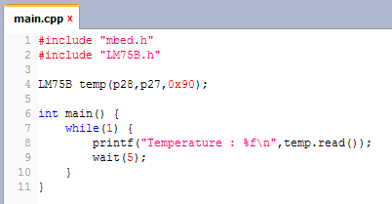
Conencting a Sensor
mbed keeps I2C simple, and a library and example exists
  I2C handbook page - http://mbed.org/handbook/I2C
  LM75B Component
  https://mbed.org/components/LM75B-Temperature-Sensor/

Slide 15
Challenge : Interfacing with sensors
Write a program that turns LED1 on at 26°C, LED2 at 27°C, LED3 and 28°C and LED4 at 29°C.
As an extended challenge, add Min/Max recordings to the program
Repeat in Fahrenheit

Slide 16
mbed
Hello World
Lab 4
Rapid Prototyping: Output device, Text LCD

Slide 17
Output device, LCD
It is not uncommon for devices that are embedded to have some sort of user interface, or display output.
This example shows an LCD connected to mbed and be driven simply from software.

Slide 18
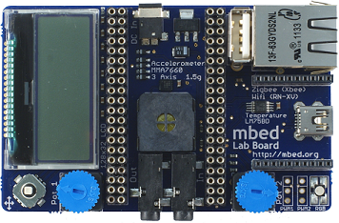
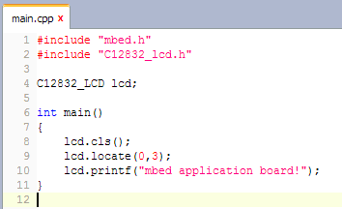
Connecting up the TextLCD
The LCD module has an SPI interface and a few digital outputs for reset, chips select and so on
mbed keeps it simple
  Standard C/C++ interface via printf
  https://mbed.org/components/128x32-LCD/

Slide 19
Challenge: Digital Thermometer
Make a digital thermometer that displays the current temperature.
If you have time, you could also add Min/Max to the display too
http://mbed.org/users/chris/code/app-board-LM75B/

Slide 20
mbed
Hello World
Lab 5
Rapid Prototyping: Mobile data logging

Slide 21
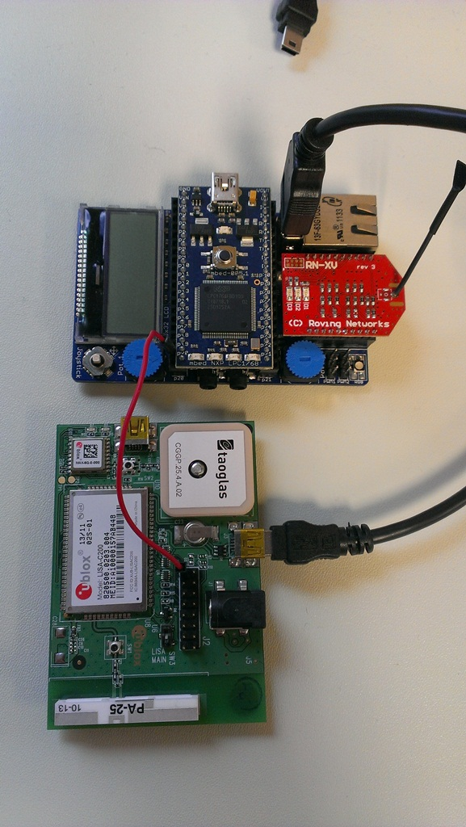
Hardware
Simple hardware :
  mbed NXP LPC1768 microcontroller
  mbed application board
  uBlox C16-20 Lisa C200 modem
  2x USB A to mini B cables
  1 Jumper wire
  DC adaptor

Slide 22
Mobile data logging
This example shows how the Sprint Mobile Broadband can be used to achieve remote data logging, where the data is sent live to online storage
The driver is now providing a socket interface over which various protocol APIs and. For this example, we are using HTML5 web sockets
Take 5 minutes to familiarise yourself with web sockets :
  https://mbed.org/components/HTML5-Websockets/

Slide 23
Websocket server channels
The mbed.org websocket uses “channels”, with “demo” as the default. To avoid conflict during a workshop, create your own channel by substituting “demo” with your own channel name
In mbed code :
  Websocket ws("ws://sockets.mbed.org:443/ws/demo/rw");
    Becomes
  Websocket ws("ws://sockets.mbed.org:443/ws/<your_channel>/rw");
In broswer URLS :
http://sockets.mbed.org/demo/viewer
becomes
http://sockets.mbed.org/<your_channel>/viewer

Slide 24

HTML5 and Websockets
New feature of HTML5 (RFC 6455) providing:
  Full-duplex communication
  Over a single TCP socket
  Standard and secure connections (ws:// and wss://)
Motivation:
  Replace existing polling techniques (AJAX) used in
  modern websites
  Provide a two-way communication without multiple HTTP connections
  Enable new classes of application
Other notable HTML5 features:
  HTML5 Canvas Element – For dynamic, scriptable 2D rendering

Slide 25
Example Program : Web sockets
An example program of how to send the current temperature as a web socket message to the mbed web socket server using the Sprint USB Modem can be found here
http://mbed.org/users/sam_grove/code/UbloxModemWebsocketTemperature/
See the output here :
http://sockets.mbed.org/summit/viewer
Experiments :
  Trigger a web socket message using navigation switch

Slide 26
Challenge : Web sockets
The previous example was write-only (“wo”) and sent data to the socket server
Try making a connection that is read-only “ro”
  To see how to receive web socket messages refer to : http://mbed.org/users/sam_grove/code/UbloxModemWebsocketTestReadOnly/
  Display received messages on the LCD, for examples see :
  https://mbed.org/components/128x32-LCD/
  To send messages, use the “sender”
  http://sockets.mbed.org/<your_channel>/sender
If you get stuck... But try to do it yourself first !
  http://mbed.org/users/sam_grove/code/UbloxModemWebsocketTestReadOnlyLCD/

