Slide 1
Hands-On Workshop: ARM mbed™
FTF-DES-F1302
Sam Grove - ARM
Michael Norman – Freescale
JUN.2015

Slide 2
Agenda
What is mbed
mbed Hardware
mbed Software
mbed Tools
mbed Support and Community
Hands-On Workshop – FRDM-K64F

Slide 3
What is mbed

Slide 4
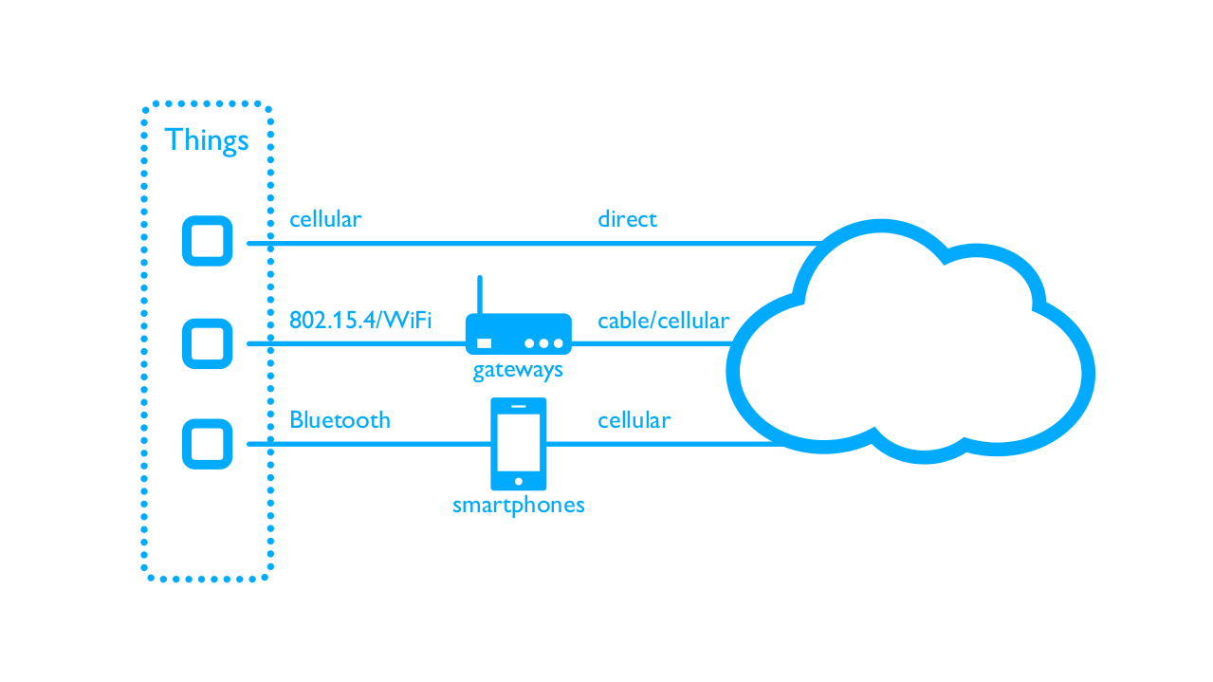
Things
Internet
Cloud Services and Platforms
mbed™ is about creating the Things

Slide 5
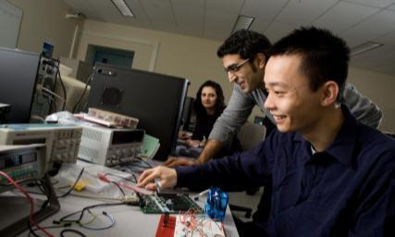
Assembler
C
Platform
1990s
2000s
2010s

Slide 6
mbed.org
Partners
{ silicon }
{ ecosystem }
{ cloud }
Developers
{ 125k people }
Software
{ sdk }
{ 12k repos }
Hardware
{ 63 platforms }
Components
{ 332 components }
Offline Tools
{ 10 Options }

Slide 7
mbed Hardware

Slide 8
Freescale Freedom Boards
Kinetis K Series
FRDM-K20D50M for Kinetis K20 MCUs
FRDM-K22F for Kinetis K22 MCUs
FRDM-K64F for Kinetis K64, K63, and K24 MCUs
Kinetis L Series
FRDM-KL02Z for Kinetis KL02 MCUs
FRDM-KL03Z for Kinetis KL03 MCUs
FRDM-KL05Z for Kinetis KL05Z and KL04Z MCUs
FRDM-KL25Z for Kinetis KL1x and KL2x MCUs
FRDM-KL26Z for Kinetis KL16 and KL26 MCUs
FRDM-KL46Z for Kinetis KL3x and KL4x MCUs

Slide 9
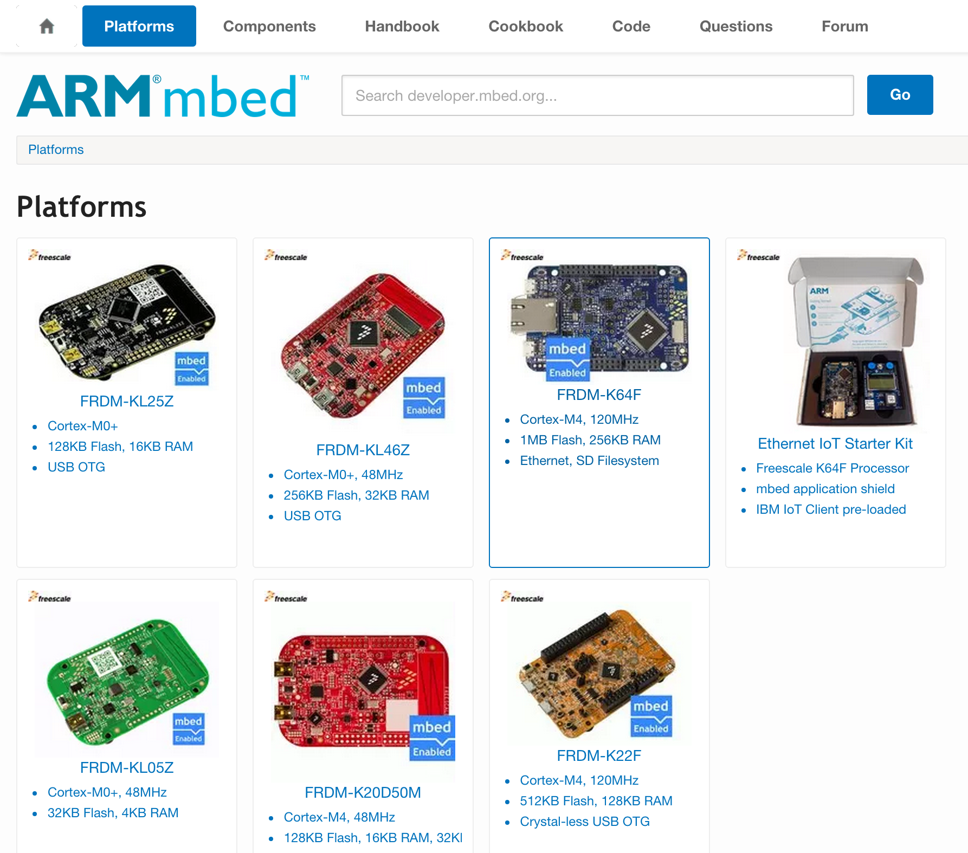

Slide 10
OpenSDA & DAPLink Interface Firmware
OpenSDA Hardware Circuit
Debug MCU
K20DX128Vxx5
GPIO
PWM
LED
MSC Bootloader
nRESET
UART RX/TX
SWD / JTAG
IDE
File System
Serial Terminal
Target Processor
Computer
GPIO / ADC
USB
Composite
Device
UART TX/RX
DAPLink
Interface
Firmware
SPI, GPIO
DAPLink Interface Firmware includes:
USB HID CMSIS-DAP Run-control debug interface
USB MSC disk for drag ‘n’ drop flash programming
USB CDC serial interface between the host and target

Slide 11
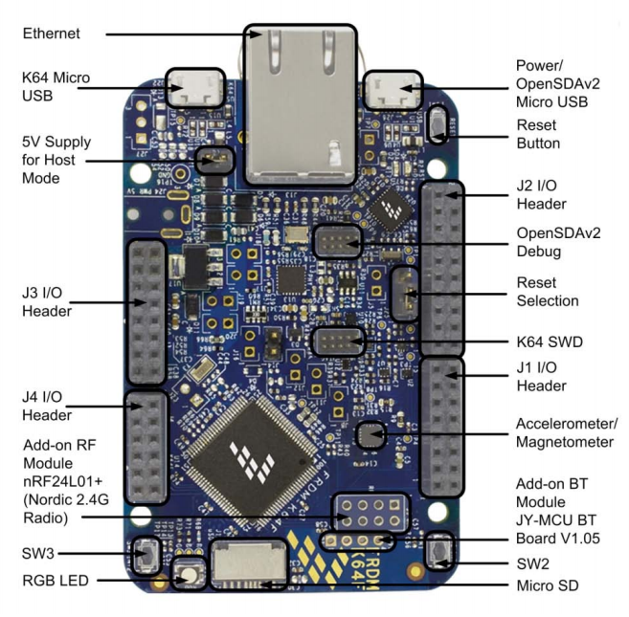
FRDM-K64F Overview
Quick, simple development experience with rich features
Easy access to MCU I/O
3-axis accelerometer/3-axis magnetometer
RGB LED
Add-on Bluetooth Module
Built-in Ethernet/Add-on Wireless Module
Micro SD
Arduino shield compatible
Flash programming functionality
enabled by OpenSDA debug interface
$29.00

Slide 12
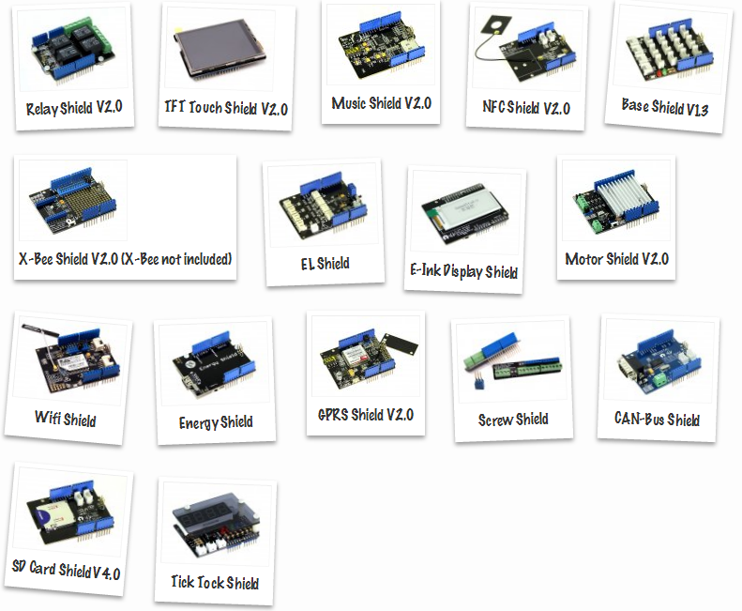
Arduino Shields

Slide 13
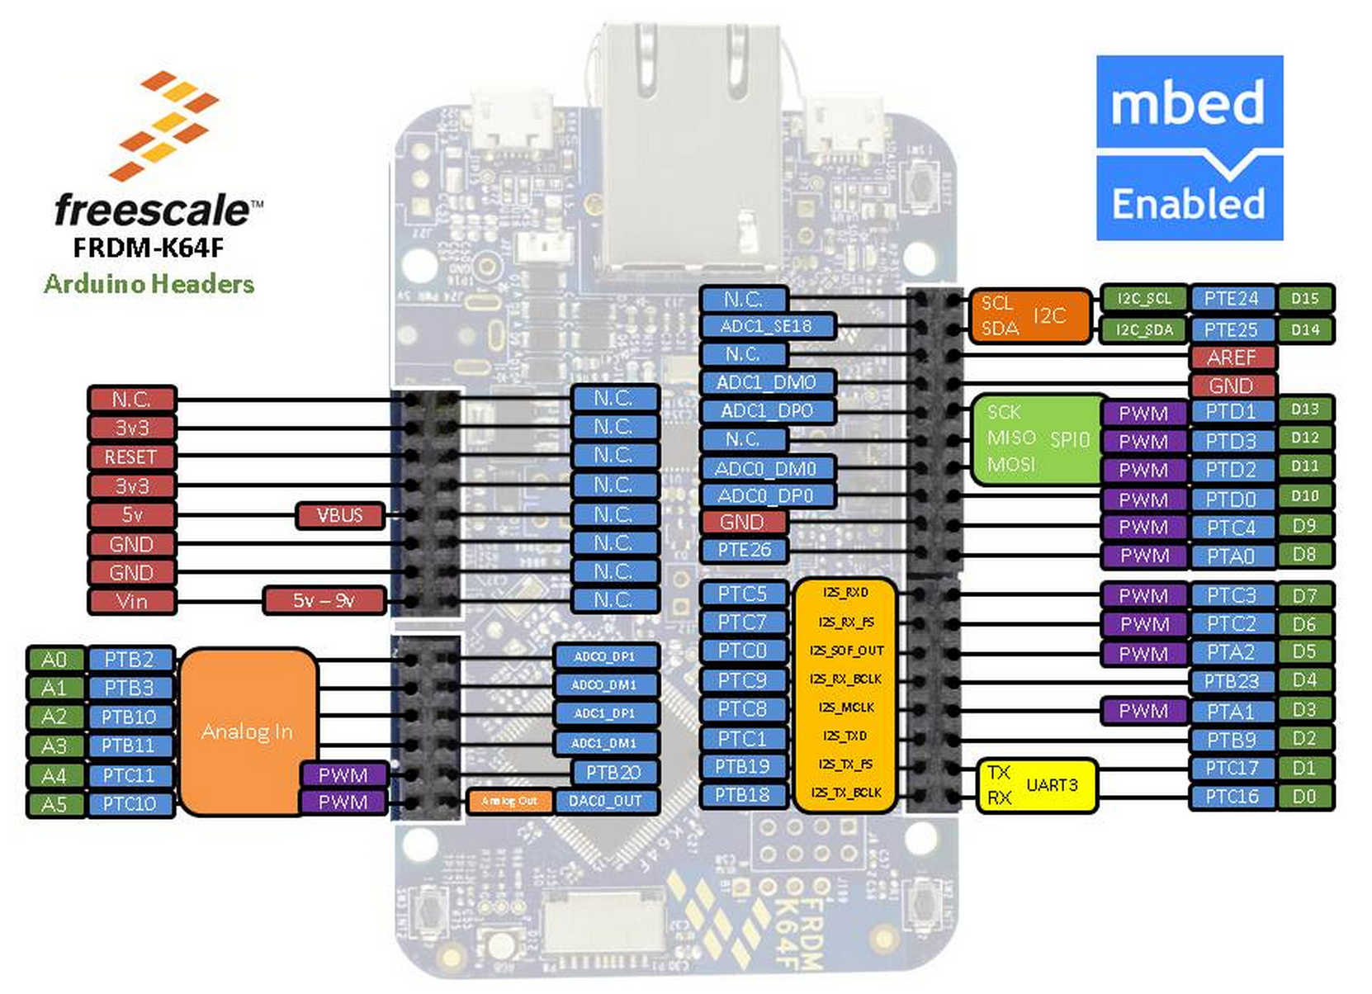

Slide 14
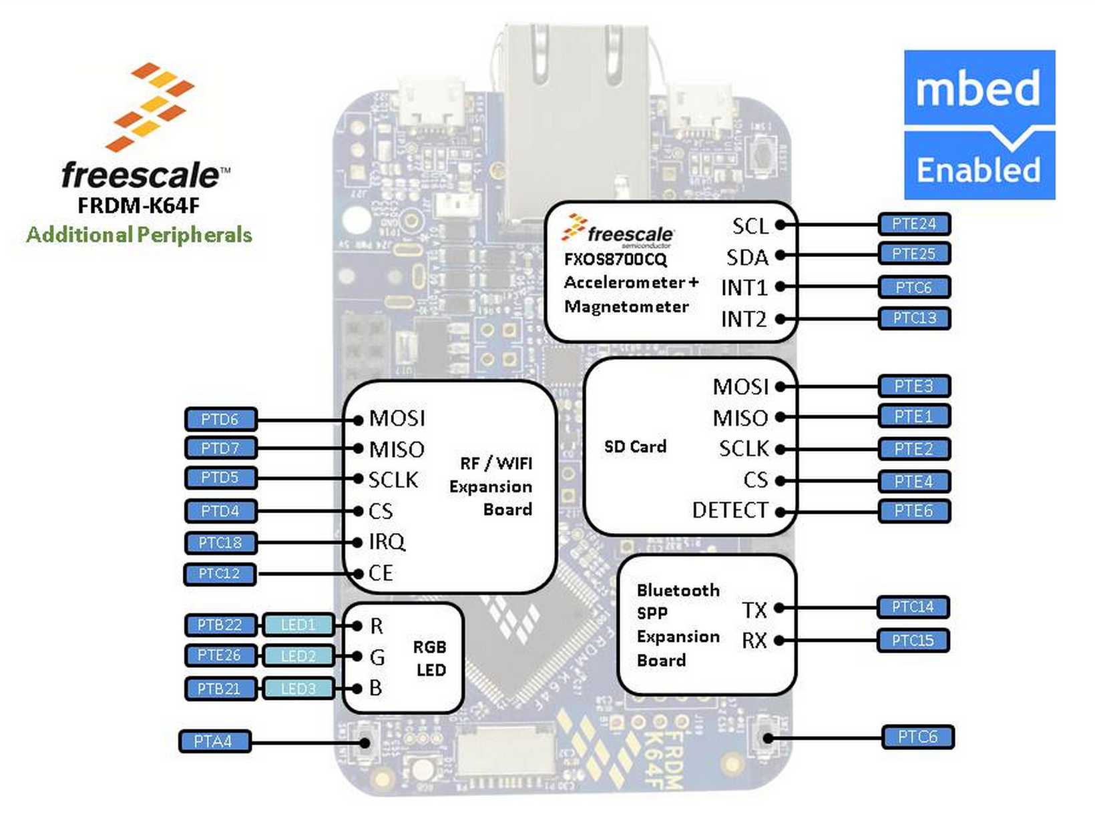

Slide 15
mbed Software

Slide 16
mbed SDK Software Stack
C/C++ User Application
Networking and USB stacks
CMSIS-RTOS implementation
Easy-to-use C++ APIs
stdlib setup, board support, systems configuration
Hardware Abstraction Layer (HAL) for MCU peripherals
CMSIS-CORE: hardware register access and Cortex-M startup code
Components
Middleware
Networking
mbed API
mbed common
mbed HAL Implementation
SDK Adapters
CMSIS-CORE
MCU Registers

Slide 17
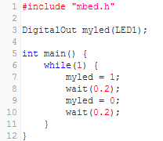
mbed Program Example
Hello World example
All startup code is taken care of by the mbed SDK – user code starts at main()
Definition of a digital output variable, myled
Use of overloaded “=“ operator
Alter digital output (and LED) by simply assigning a value to the variable.

Slide 18
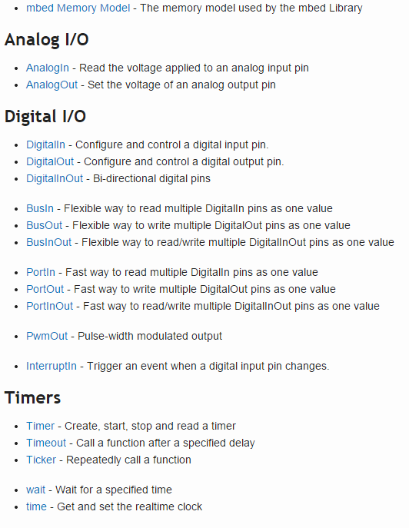
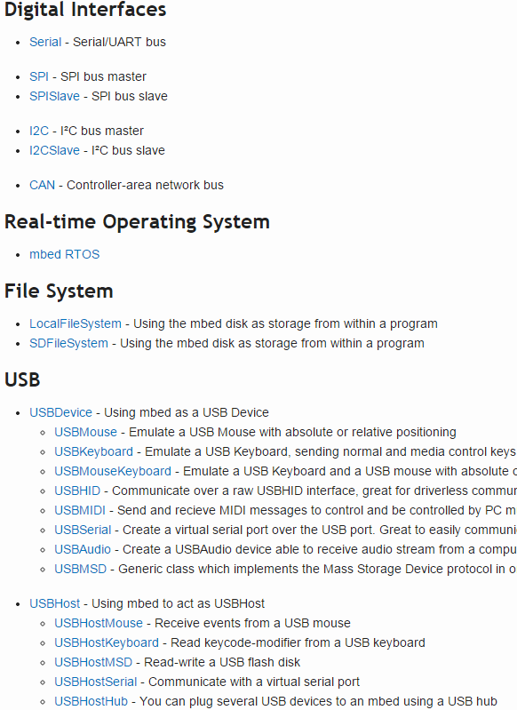
http://developer.mbed.org/ handbook

Slide 19
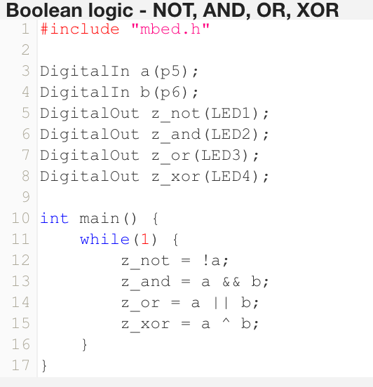
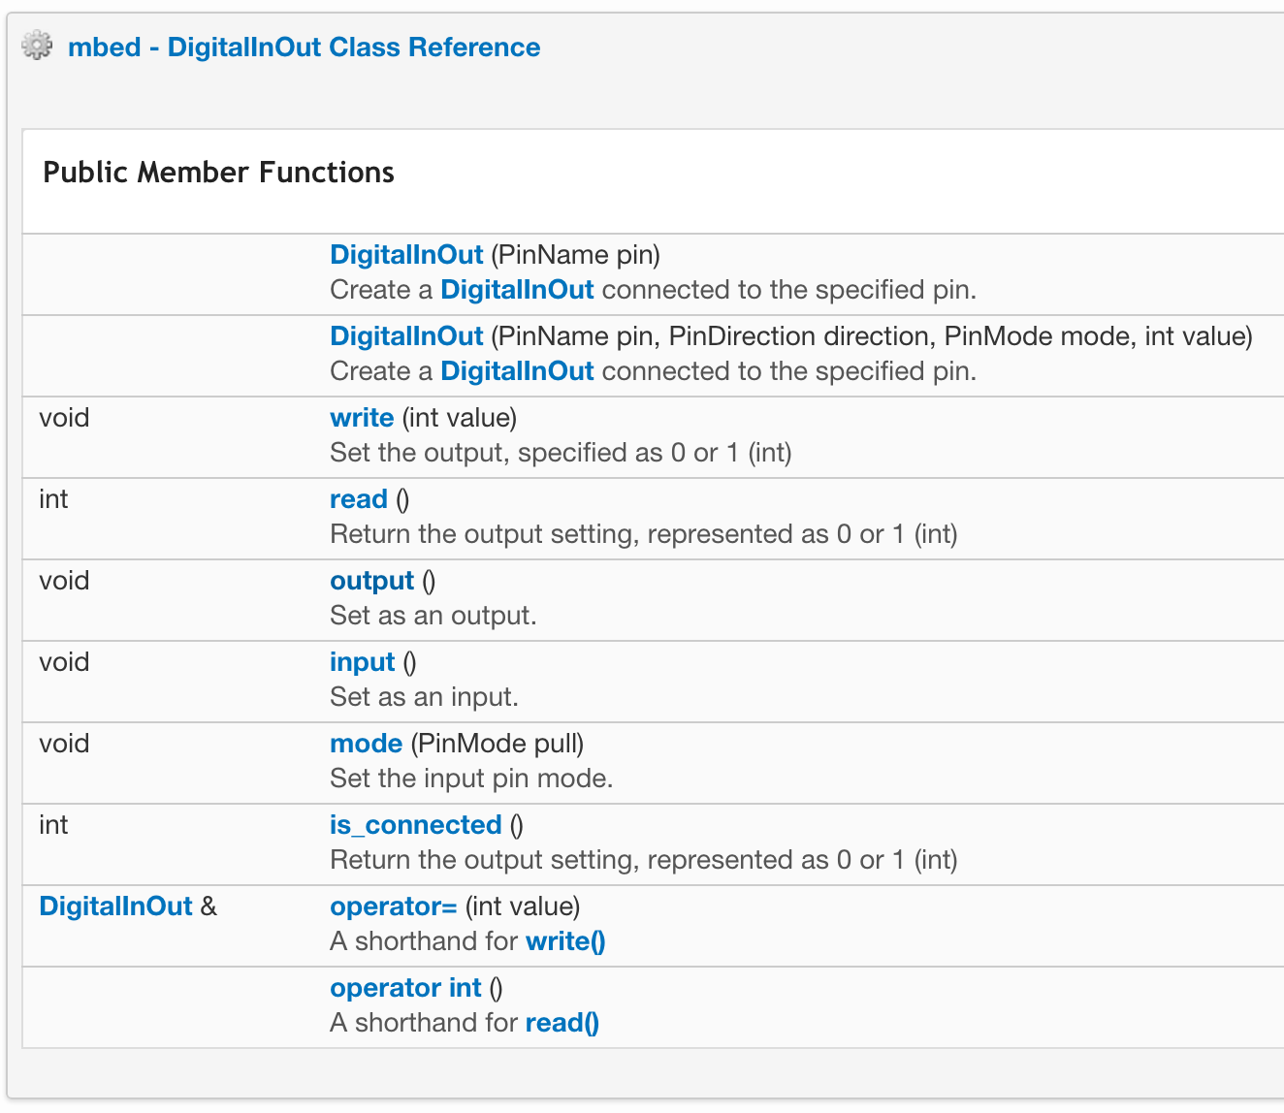
Digital Inputs and Outputs

Slide 20
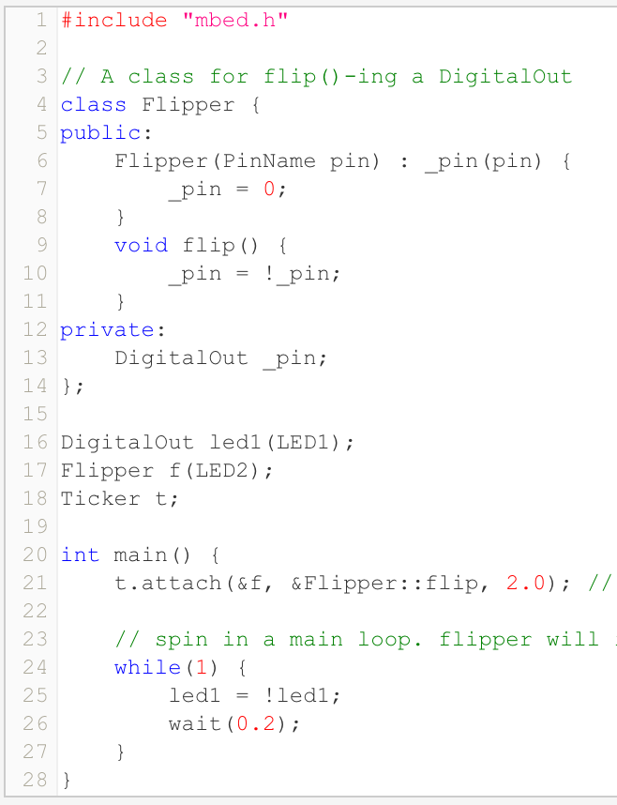
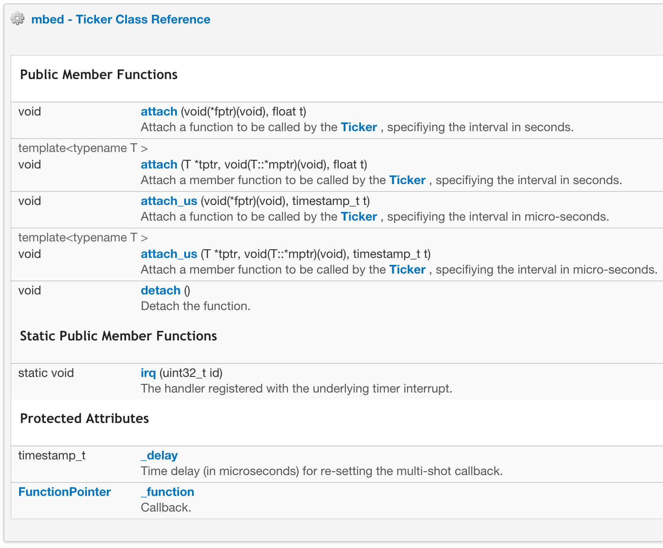
Ticker

Slide 21
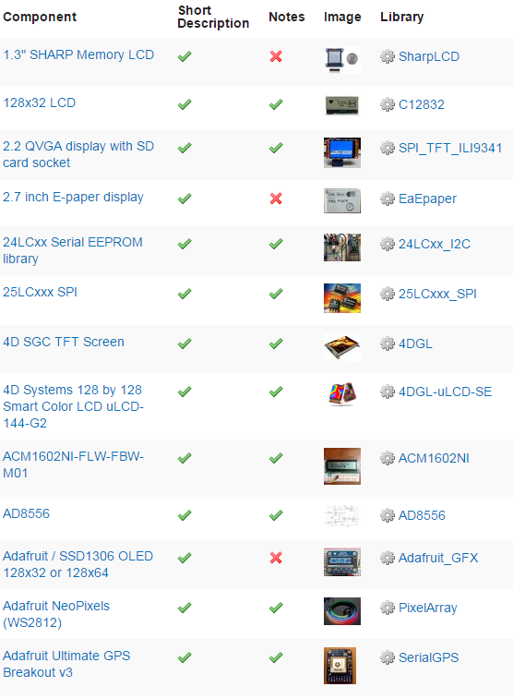
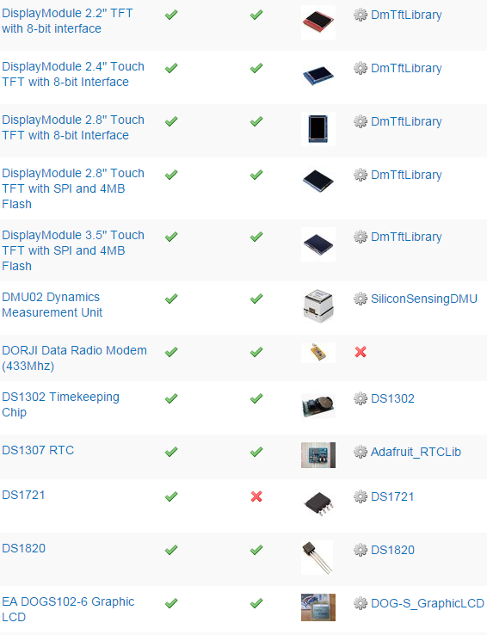
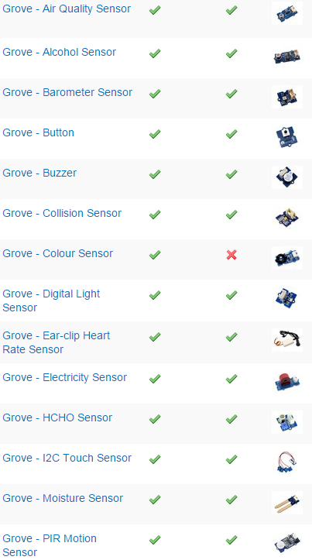
http://developer.mbed.org/ components

Slide 22
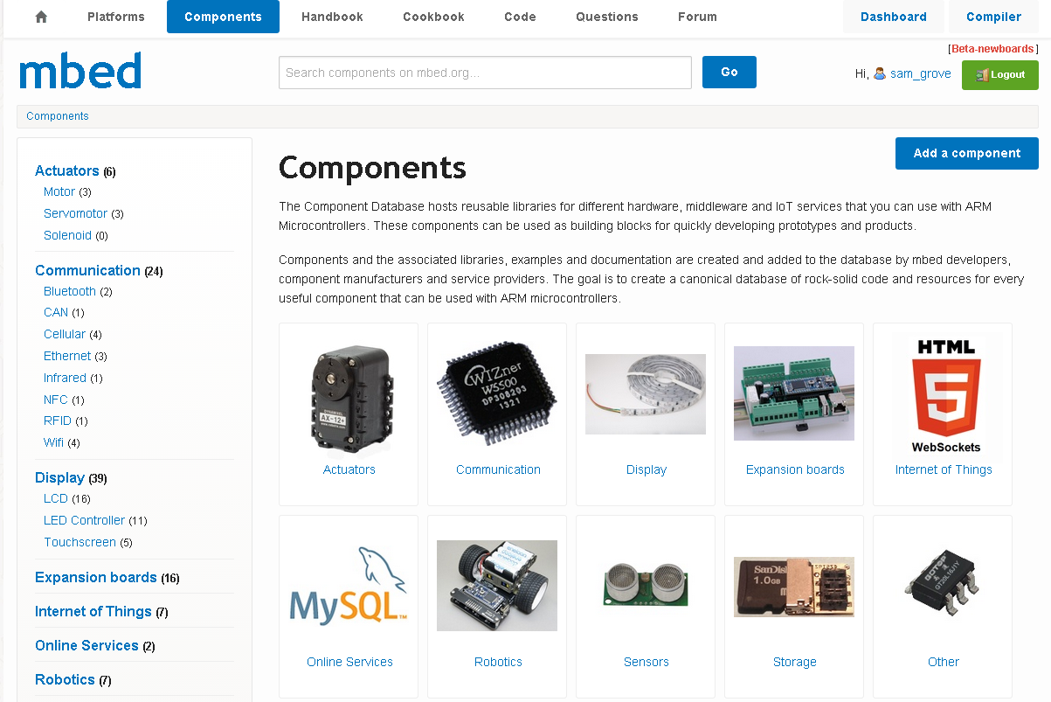
Component Database
Components are portable across all platforms and tools

Slide 23
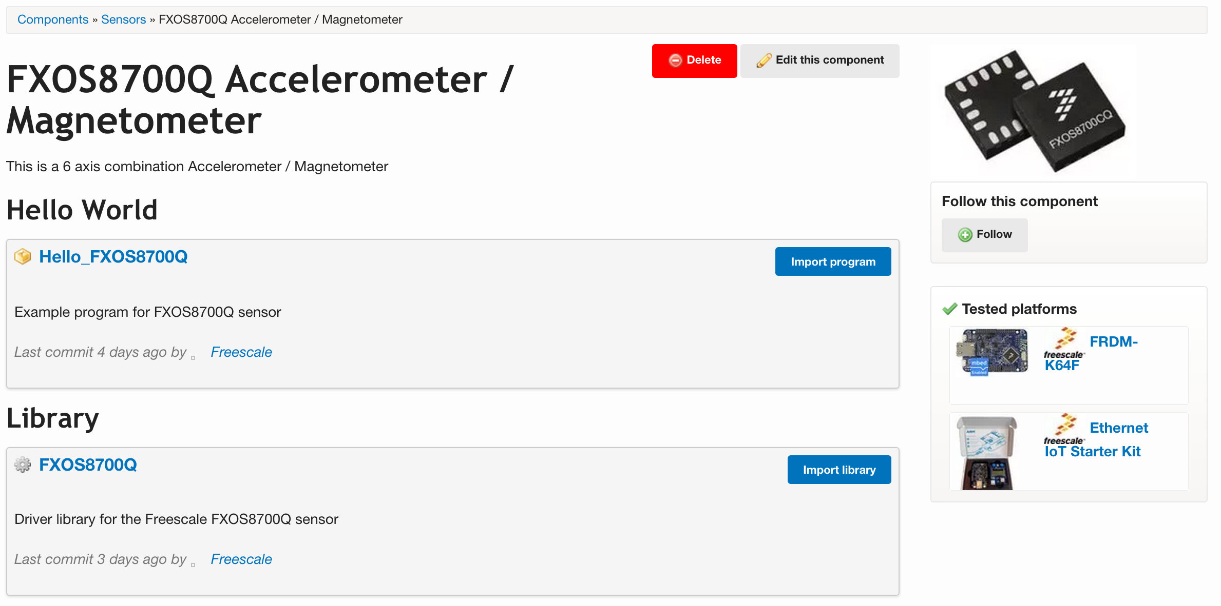
Component Entry
Example program to evaluate the component
Directly import into
Your current program

Slide 24
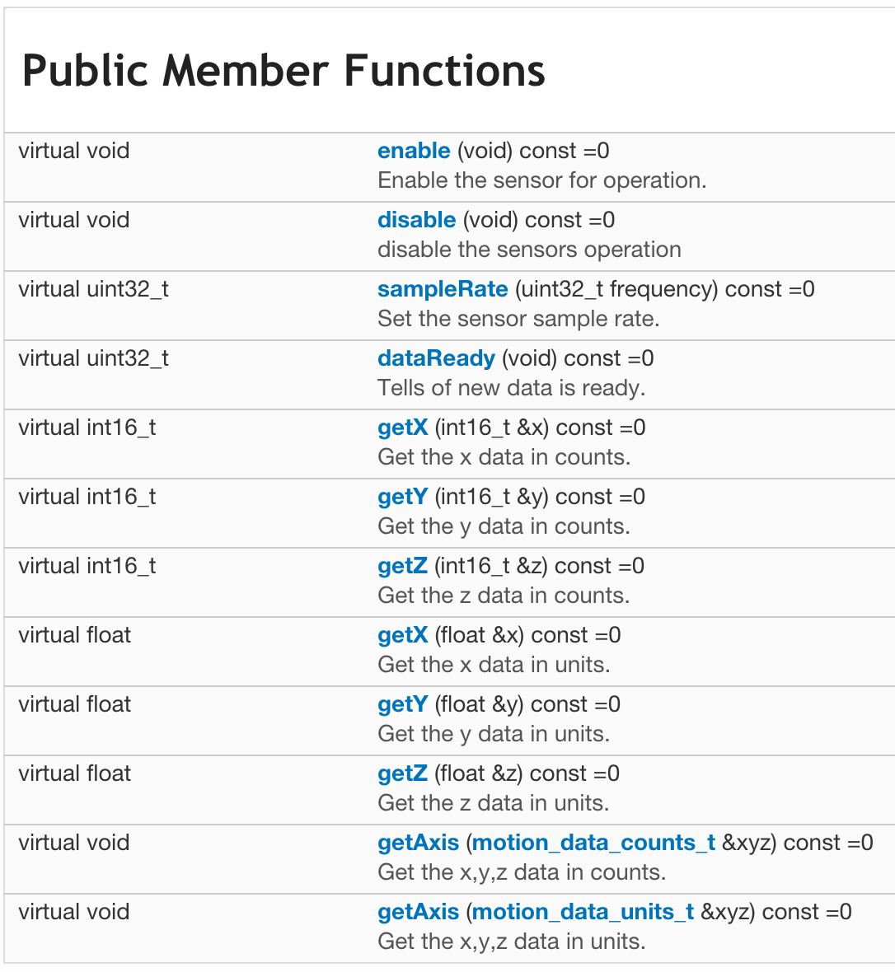
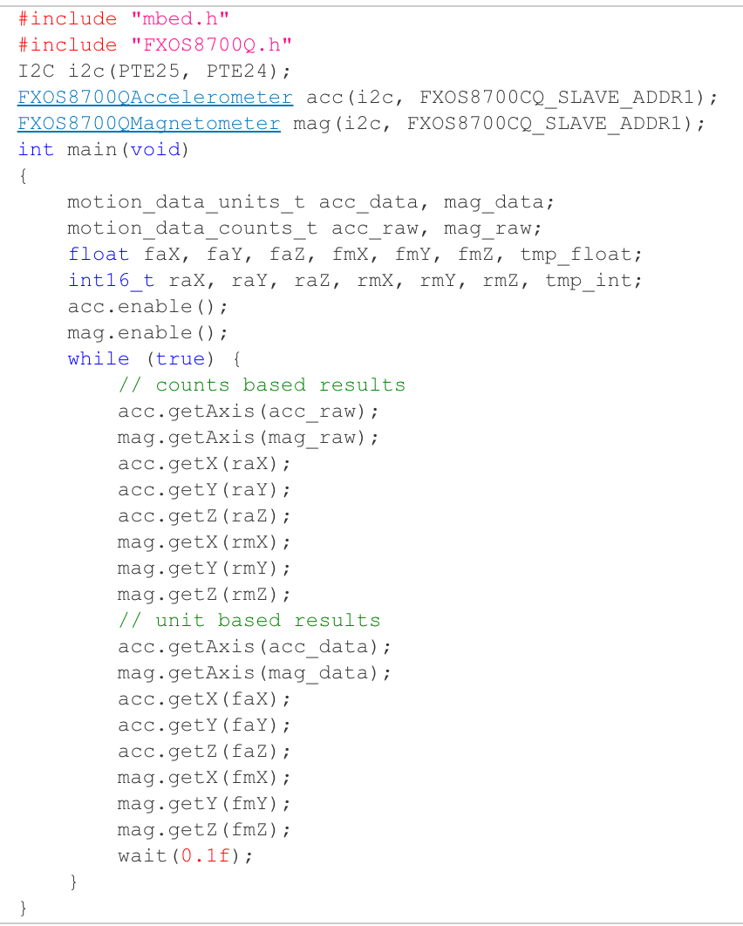
FXOS8700Q

Slide 25
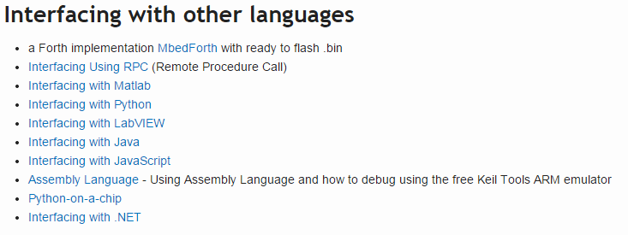
http://developer.mbed.org/cookbook

Slide 26
mbed Tools

Slide 27
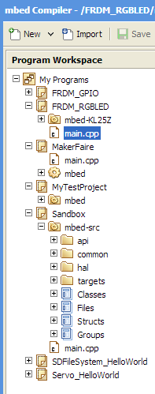
mbed Online IDE
Cloud-based ARM professional C/C++ compiler
Private account based access
Pre-configured compiler that “just works”
Informative compile-time messages with links to error and error message wiki
Provides build information including RAM and flash usage is a graphical display
Generates binary: save to mbed enabled hardware
Browser-based editor and project manager
Syntax highlighting
Keyboard shortcuts
Integrated project manager
Tabbed file organizer
Code auto-formatter
Easily imports mbed software
libraries and examples
Runs on Windows, Mac iOS,
Android, Linux

Slide 28
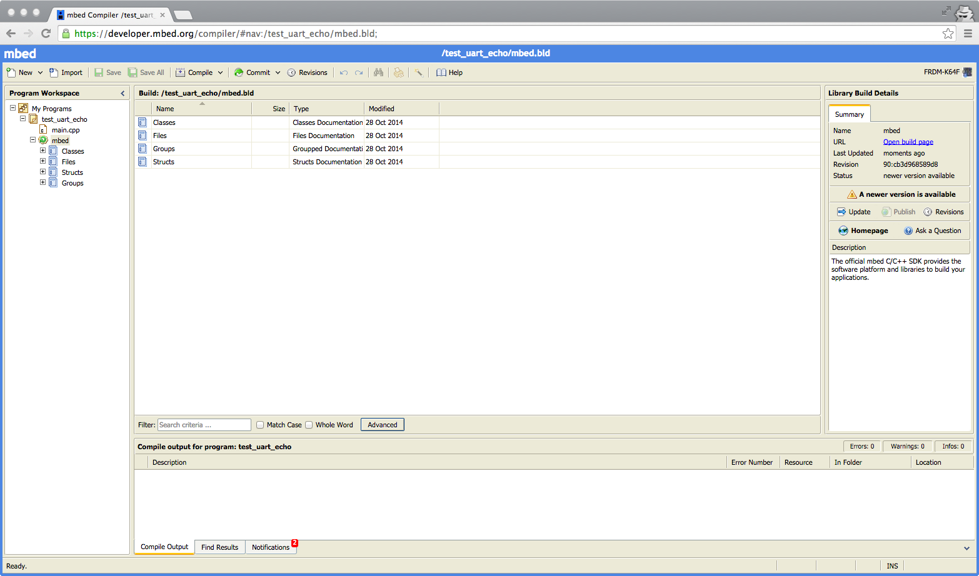
Online IDE and Compiler
Platform Selection
Programs Workspace
Integrated Version Control
Program/Library Details

Slide 29
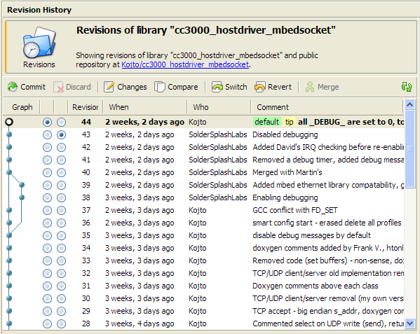
Revision Control and Collaboration
Built-in revision system
Mercurial DVCS
Collaboration workflow
Local version control
Commit a version of your project, and view the revision history
View changes a version made, and compare changes between versions
Switch and revert to a different version
Branch and merge versions
Collaborate with others
Pull - Copy changes from remote repository to a local repository in your workspace.
Push - Copy changes from local repository to a remote one.
Fork - Create remote repository on mbed.org from imported local repository
Publish - Publish changes to existing repository (push) or create new one (fork)
Update - Pull from a remote repository and switch your local repository to the latest revision.

Slide 30
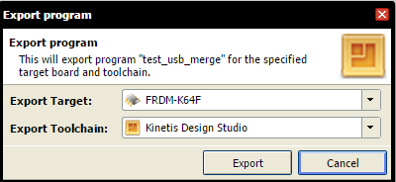
Exporting to Offline Tools
The mbed Compiler can export to professional toolchains:
Kinetis Design Studio
Keil uVision
ARM DS-5
GCC
IAR Embedded Workbench
CooCox
Emblocks
Zip with repositories
Why export?
Run-control debug
Optimizations
Automated testing

Slide 31
mbed Support

Slide 32
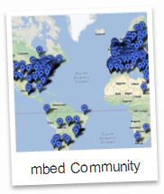
mbed Community
Developers
Vendors
Cloud services
Manufacturers
Components
Operators

Slide 33
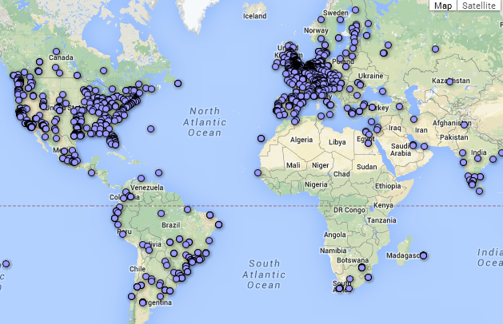
mbed Community Support
Worldwide community of developers
Shared context of
common tools
common SDK
common hardware
common experiences
Issues can be reproduced and resolved efficiently

Slide 34
mbed – Moving from Prototype to Production

Slide 35
Open Source Software
mbed SDK was open sourced in Feb, 2013
Full source code now available
Apache 2.0 Open Source License
Can modify the source
Can distribute
Can sublicense
Allows use in commercial products
Not required to open-source the resulting software

Slide 36
Open Source Software
Import it into the online IDE:
Clone the GitHub repository:

Slide 37
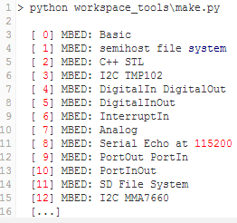
mbed Test Tools and Build Scripts
mbed sources include Python build and test scripts
Released under Apache 2.0 license
Build system
command line builds of libraries
build and run test projects
Test system
automated test scripts
Scripts can program and reset the target
Results are printed over serial port
pyOCD: python library for accessing CMSIS-DAP

Slide 38
Script commands
> python build.py –m K64F –t GCC_ARM –j0 -c
> python project.py –m K64F –i kds –c –p 25

Slide 39
Hands-On

Slide 40
Hands-On Agenda
Lab 1 – Hello World
Input / Output and serial module
Challenge – Change LED state based on button state
Challenge – Read serial characters and change RGB LED state
Lab 2 – Interrupts and Timers
Interrupts and timers
Challenge – Drive RGB LED while sleeping between state change
Challenge – Change RGB LED state but sleep between state change
Lab 3 – Using Sensors
I2C accelerometer / magnetometer
Challenge – Control an LED in a meaningful way based on the sensor readings
Challenge – Add sensor handling using the RTOS
h t t p : / / m b e d . o r g / f t f 2 0 1 5

Slide 41
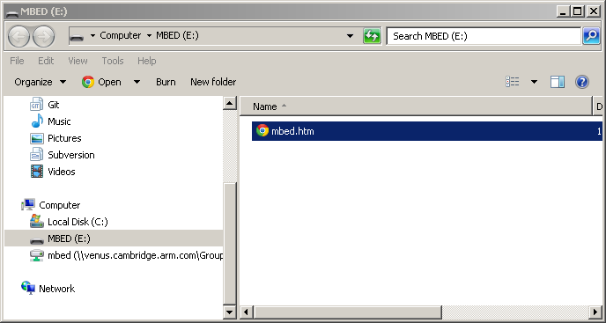
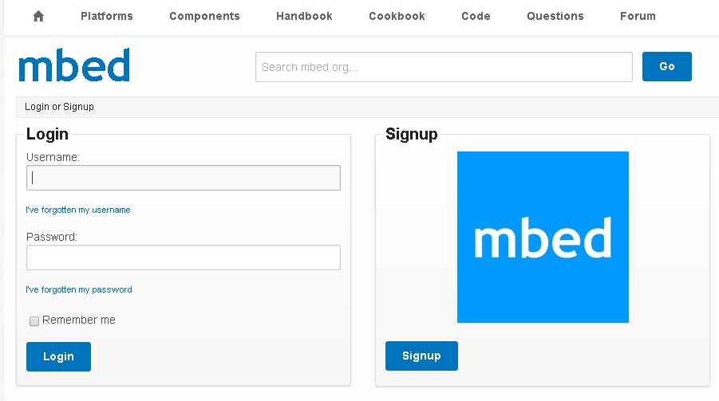
Creating an Account
Registration
Connect a mbed platform to a Windows / Mac / Linux computer
mbed platforms is identified as a mass storage device (USB disk)
Double-click the mbed.htm file on the mbed USB disk
Log in or sign up for a new account

Slide 42
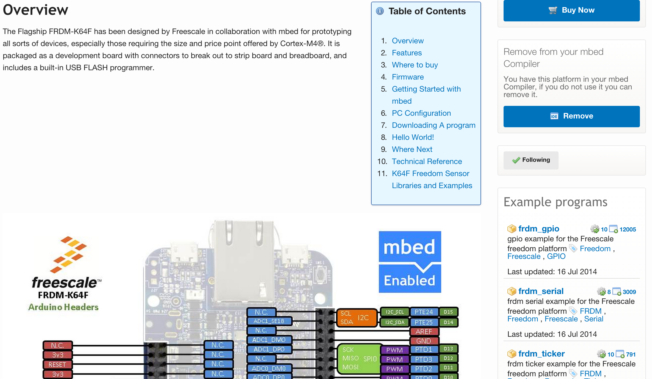
Know your Hardware
Connection diagram and example programs on the platform page
Example
Program
Connection
Diagram

Slide 43
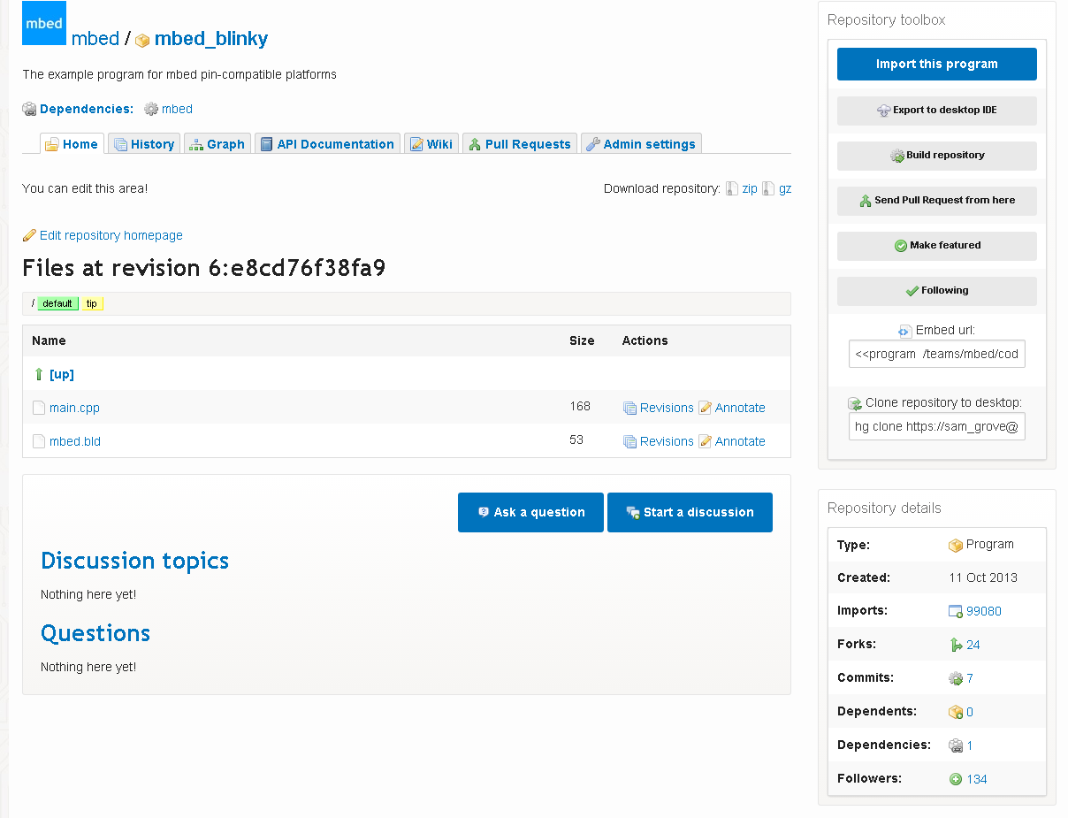
About Programs

Slide 44
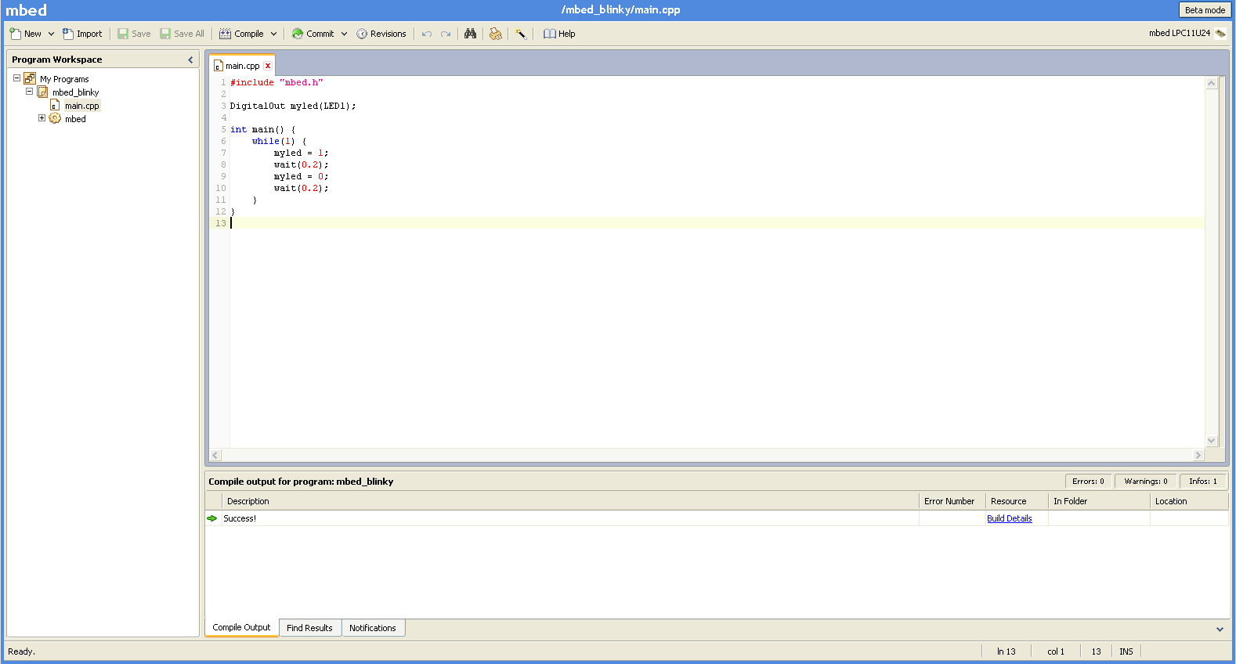
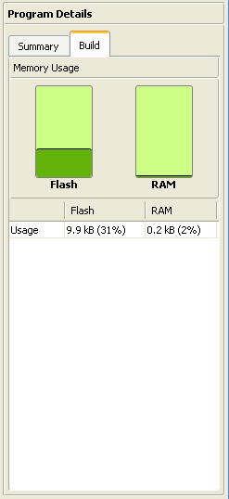
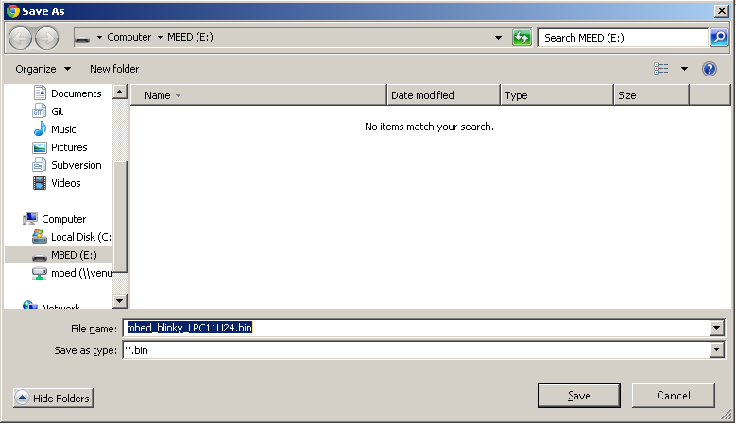
Compiling your Program

