Slide 1
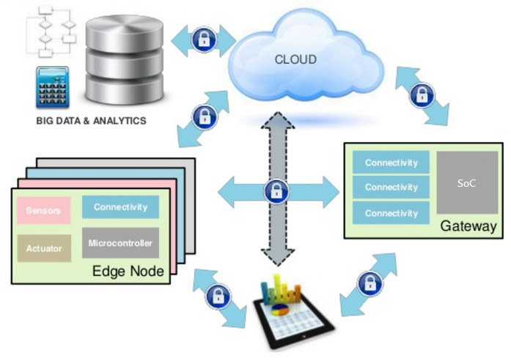
IoT 技術架構簡介
M2M 通訊協定

Slide 2
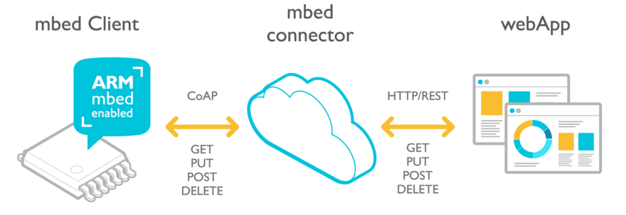
mbed IoT Device Platform

Slide 3
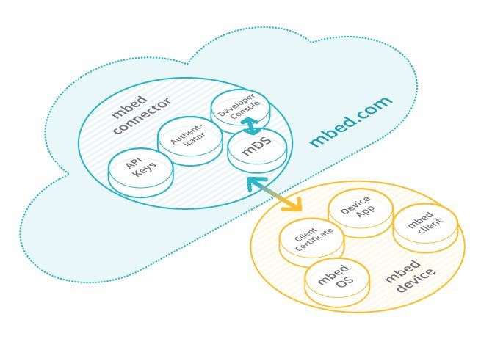
ARM mbed IoT Device Platform
mbed Device Connector Service
https://connector.mbed.com/
https://developer.mbed.org

Slide 4
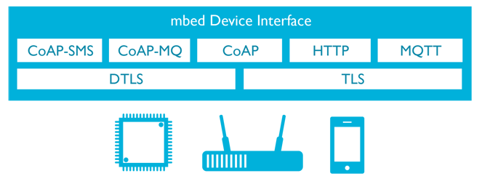
mbed IoT Device Platform
mbed Device Server
REST API
CoAP
HTTPS
webAPP
mbed Client
HTTP

Slide 5
WebAPP技術
Backend-end
The REST API URL for all requests for mDS
Node.js+Express (Node.JS web framework)
Node.js http
Node.js Socket.io
"mbed-connector-api"
hbs: Handlebars HTML template
Front-end
JQuery
JS/Socket.io (socket.io-client)
JSON Parser

Slide 6
WebAPP技術
https://api.connector.mbed.com
All data format is JSON
mbed DS
RESTful Web interfaces with Access Key
HTTPS
mbed-connector-api
JQuery
Socket.io
Socket.io
web Socket
HTML
CSS
JavaScript
HTTP
Express
node.js

