Slide 1
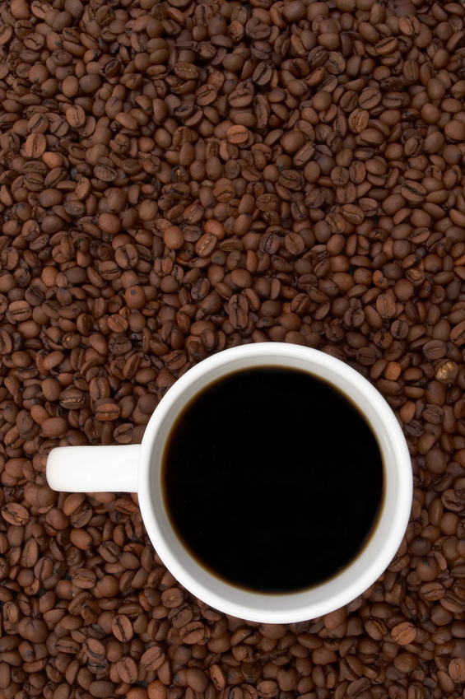
MBED Coffee Roaster
Eric Patterson
Elza Mathew
Erin Deye

Slide 2
Project Description
For our design project we created a temperature controlled coffee roaster. We used a nichrome wire to roast the coffee beans and an AC motor to rotate the basket holding the beans so that they were roasted evenly. A thermocouple read in the internal temperature, and a hysteresis controller was used to regulate the heating element. The user is able to control the temperature of the system using a touch panel. They are also able to monitor the temperature and elapsed time on an LCD screen.

Slide 3
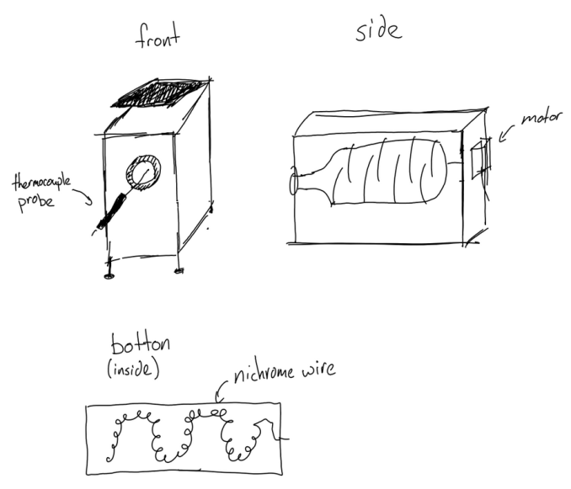
Components List & Initial Sketch
Mbed (LPC-1768)
K-Type Thermocouple (MAX31855)
LCD Screen (uLCD-144-G2)
Capacitive Touch Panel (MPR121)
Solid State Relay (SSR-40DA)
Nichrome Wire (19-AWG, 14.5A, 190”)
High Torque Low Speed AC Motor
Misc. Materials:
Basket to hold coffee beans
Ceramic supports for nichrome wire
Box to hold roasting system

Slide 4
Control System Block Diagram
LCD Screen
5V
GND
TX
RX
RES
Vout
GND
P10
P9
P11
mbed
Solid State
Relay #1
P22
GND
P3
P4
Capacitive
Touch Panel
Gnd
SDA
SCL
IRQ
Vcc
GND
P28
P27
P26
Vout
Solid State
Relay #2
P30
GND
P3
P4
Thermocouple
Vin
GND
D0
CS
CLK
Vout
GND
P6
P20
P7

Slide 5
Heating System Block Diagram
Motor
Solid State
Relay #1
Wall Outlet
P1
P2
Solid State
Relay #2
P1
P2
Nichrome Wire

Slide 6
Control System

Slide 7
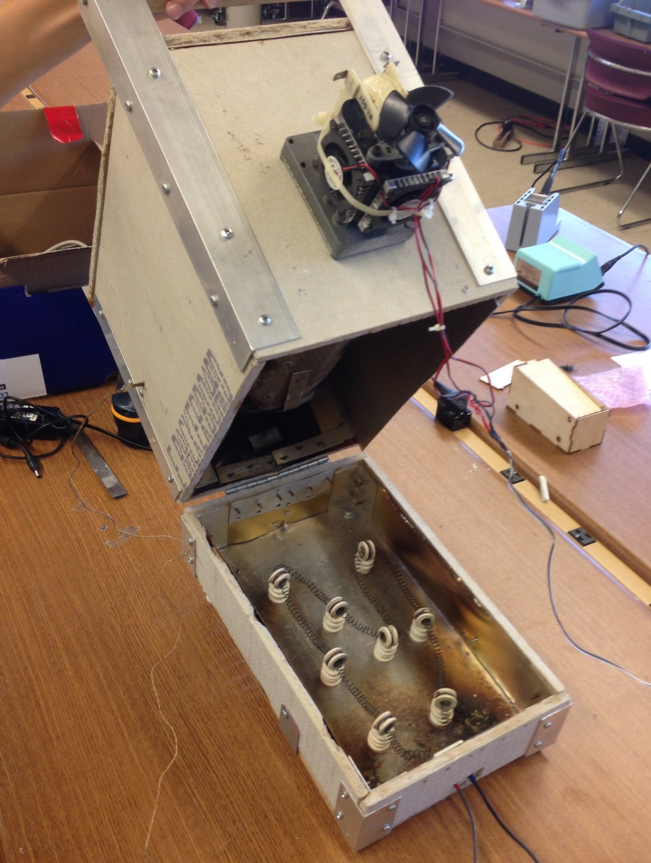
Heating System

Slide 8
User Interface
Motor
On
Motor
Off
Reset Temp.

Slide 9
Coffee Bean Roaster Protocol
Procedure:
Power control system.
Set temp. to 450 degrees.
Turn on motor.
Set temp. reached.
Put in beans.
Follow heating profile.
Pour beans out.
Turn off entire system.

Slide 10
Working Coffee Bean Roaster
https://www.youtube.com/watch?v=uuBk4l6XnQU

Slide 11
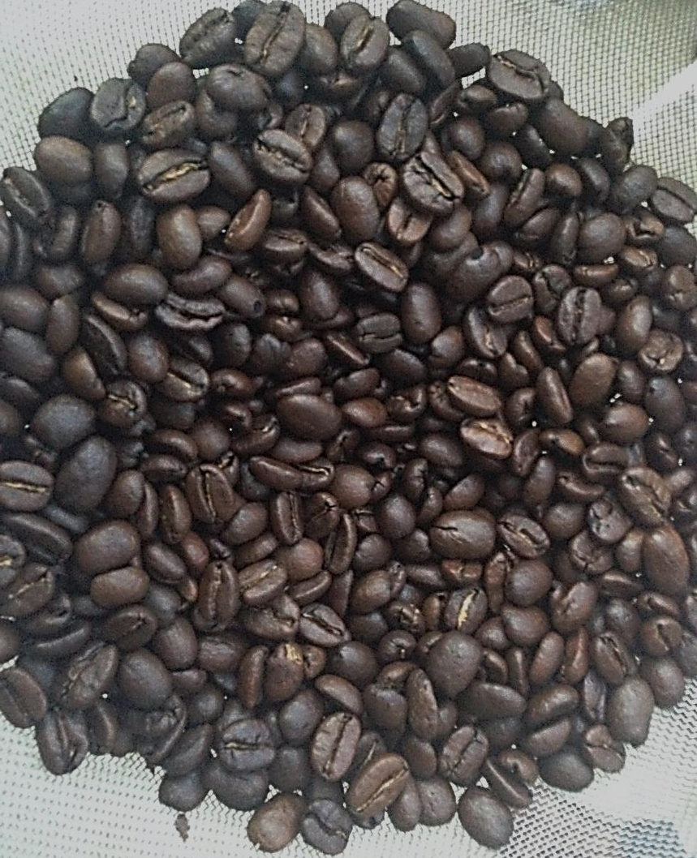
Coffee Beans Before and After

Slide 12
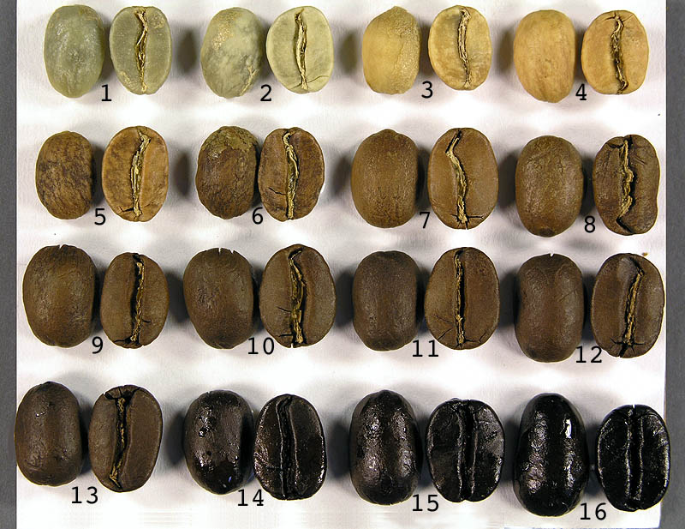
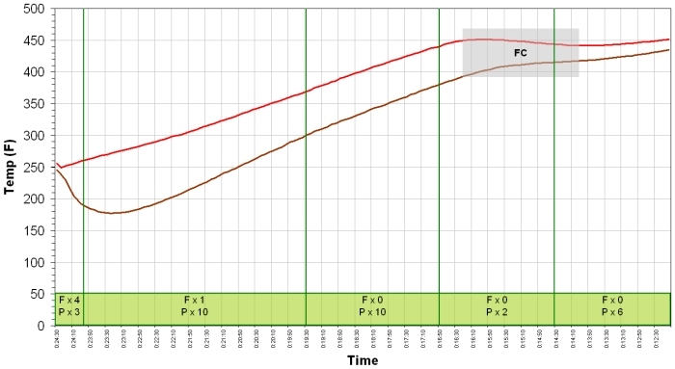
Results
Preheats to 450 F degrees in approx. 20 minutes.
Accuracy: -1 degree to +3 degrees from set temperature.
Up to 1 lb. of beans can be roasted at a time.
Roasting takes approx. 12 minutes.

Slide 13
Future Work
“Internet of Things” - twitter, website, or app
Improve bean load and unload
Heating element – make faster, bigger heating element, currently takes some time to get up to temperature.
Better user interface – larger screen.
Wire management.
Plot graph of temperature over time.

Slide 14
Notebook Page
http://developer.mbed.org/users/ericspatterson/notebook/mbed-coffee-roaster/

